Slide 1
Object Oriented Programming—C++ Lecture3 Initialization & References
Qijun Zhao
College of Computer Science
Sichuan University
Spring 2023

Slide 2
Today
- Initialization
- Using auto
- References
- If time: Const

Slide 3
Definition
Initialization: How we provide initial values to variables

Slide 4
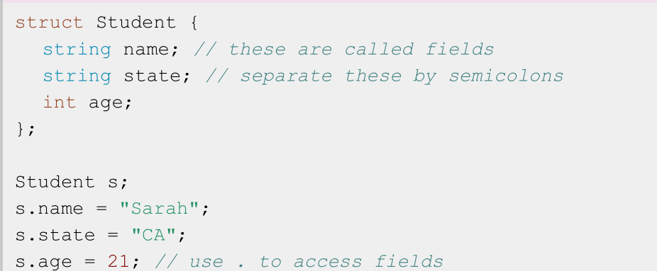
Reminder: Structs in Code

Slide 5
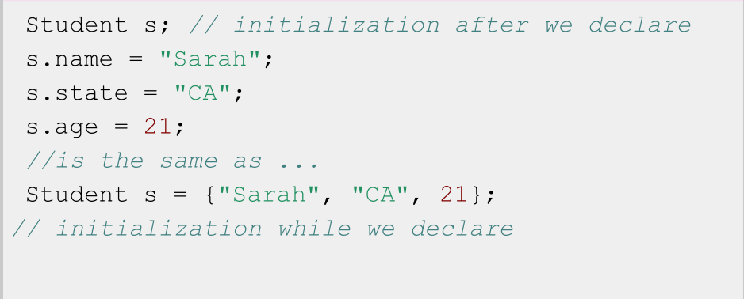
Recall: Two ways to initialize a struct

Slide 6
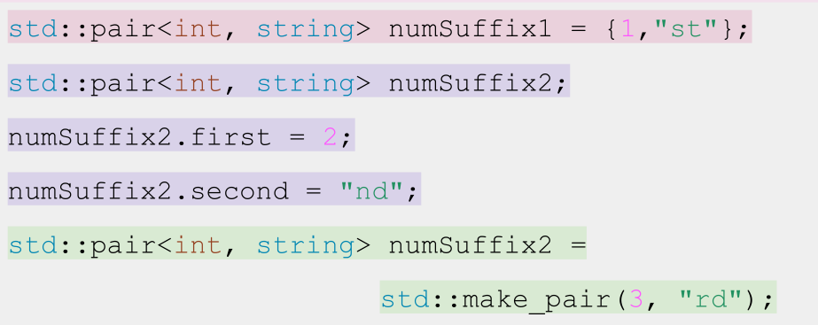
Multiple ways to initialize a pair...

Slide 7
Definition
Uniform i nitialization: curly bracket initialization. Available for all types, immediate initialization on declaration!

Slide 8
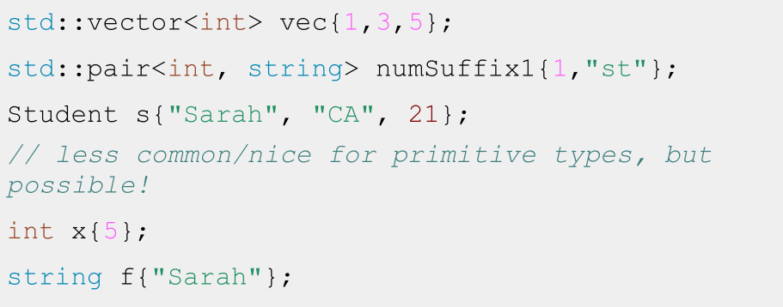
Uniform Initialization

Slide 9
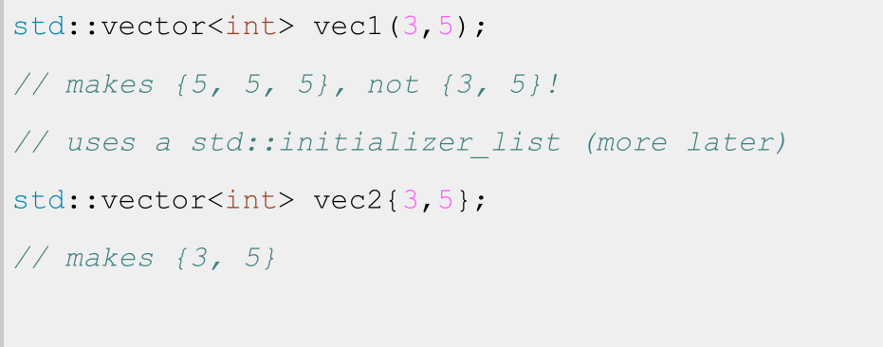
Careful with Vector initialization!

Slide 10
TLDR: use uniform initialization to initialize every field of your non-primitive typed variables - but be careful not to use vec(n, k)!

Slide 11
Today
- Initialization
- Using auto
- References
- If time: Const

Slide 12
Definition
Recap: Type Deduction with auto
auto: Keyword used in lieu of type when declaring a variable, tells the compiler to deduce the type.

Slide 13
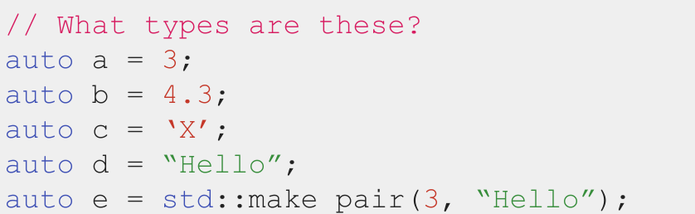
Type Deduction using auto
📝 auto does not mean that the variable doesn’t have a type.
It means that the type is deduced by the compiler.

Slide 14
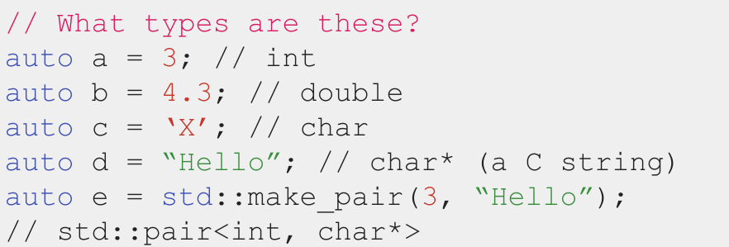
Type Deduction using auto
📝 auto does not mean that the variable doesn’t have a type.
It means that the type is deduced by the compiler.

Slide 15
Definition
auto: Keyword used in lieu of type when declaring a variable, tells the compiler to deduce
the type.

Slide 16
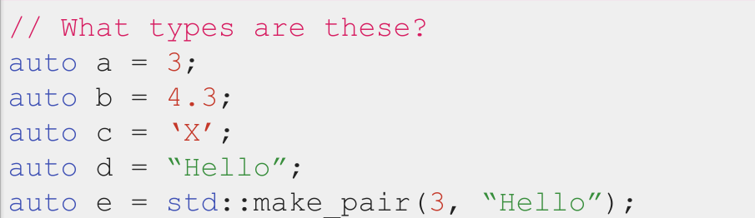
Type Deduction using auto
📝 auto does not mean that the variable doesn’t have a type.
It means that the type is deduced by the compiler.

Slide 17

Type Deduction using auto
📝 auto does not mean that the variable doesn’t have a type.
It means that the type is deduced by the compiler.

Slide 18

auto does not mean that the variable doesn’t have a type.
It means that the type is deduced by the compiler.

Slide 19
Code Demo!
quadratic.cpp

Slide 20
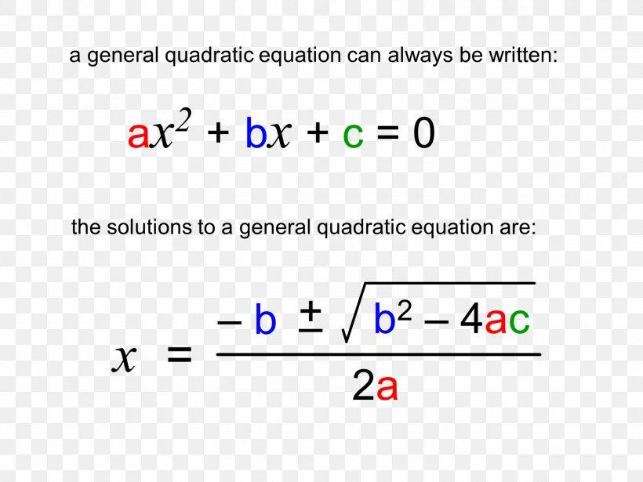
Radical
If Radical < 0, no real roots

Slide 21
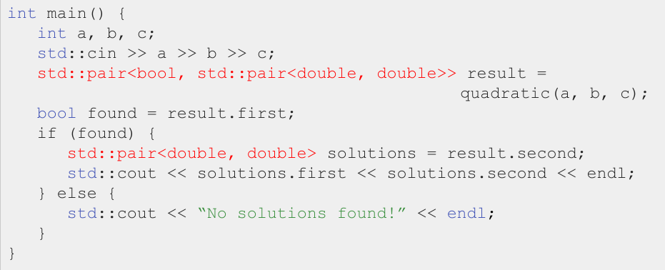
Quadratic: Typing these types out is a pain...

Slide 22
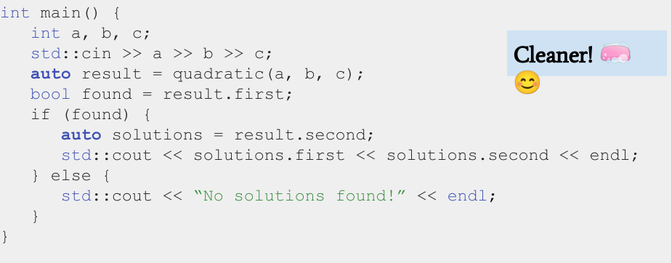
Quadratic: Typing these types out is a pain...

Slide 23
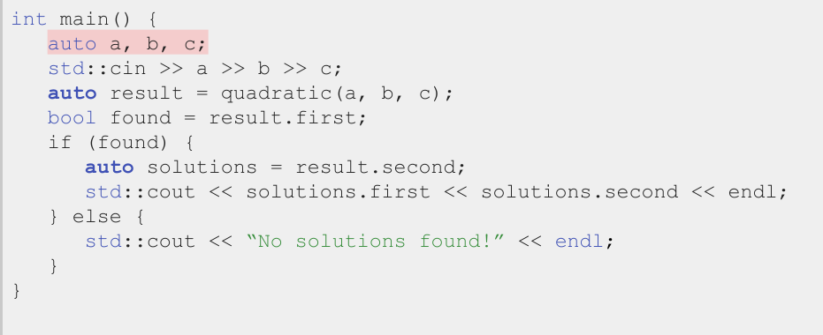
Don’t overuse auto!

Slide 24
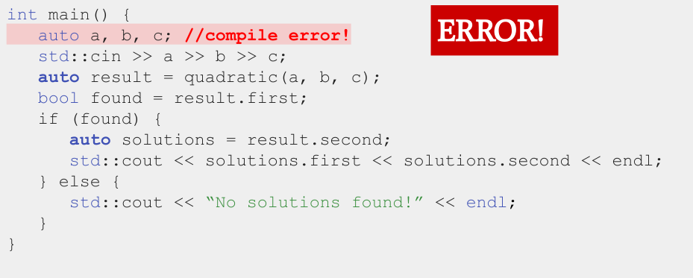
Can’t deduce the type b/c no value provided

Slide 25
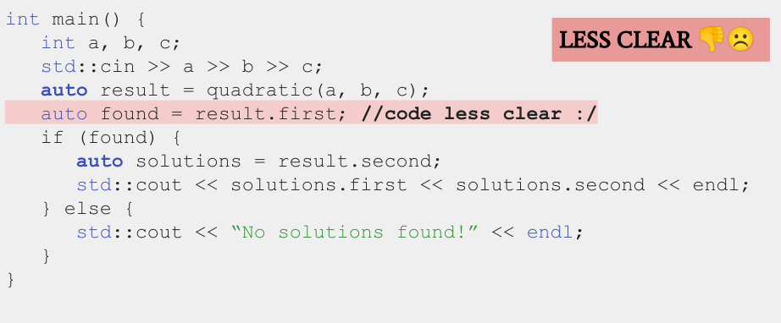
For simple types (like bool) type it out

Slide 26
Don’t overuse auto
...but use it to reduce long type names

Slide 27
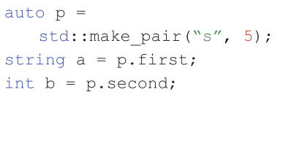
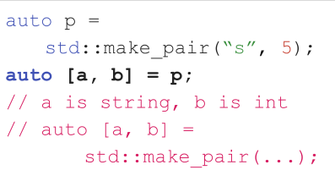
Structured Binding
Structured binding lets you initialize directly from the contents of a struct
Before
After
📝 This works for regular structs, too. Also, no nested structured binding.

Slide 28
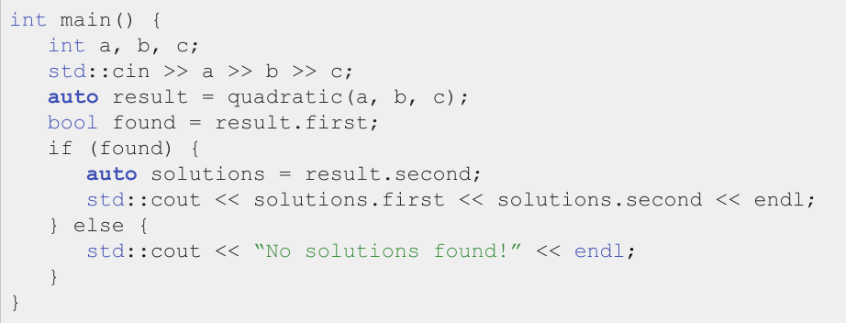
A better way to use quadratic…

Slide 29
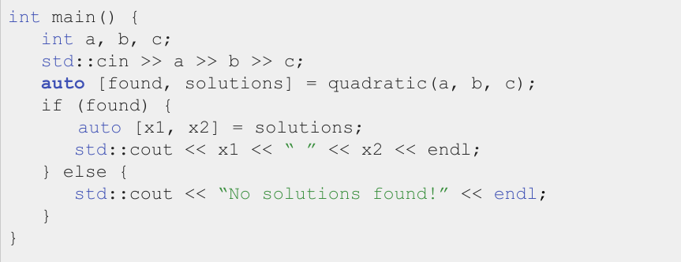
Using Structured Binding
📝 This is better is because it’s semantically clearer: variables have clear names.

Slide 30
Today
- Initialization
- Using auto
- References
- If time: Const

Slide 31
Definition
Reference: An alias (another name) for a named variable

Slide 32
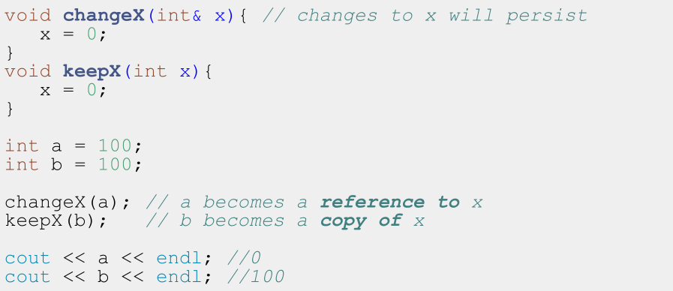

Slide 33
Standard C++ vector (intro)

Slide 34
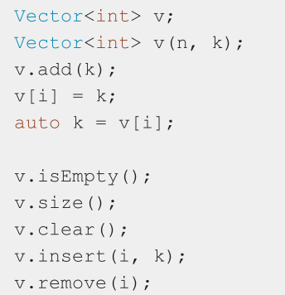
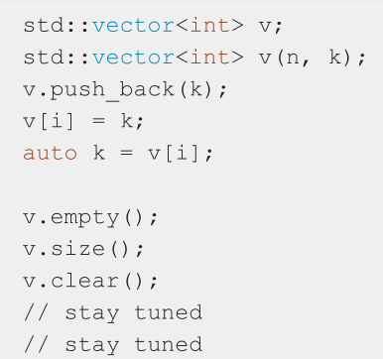
Stanford Vector vs Standard std::vector

Slide 35
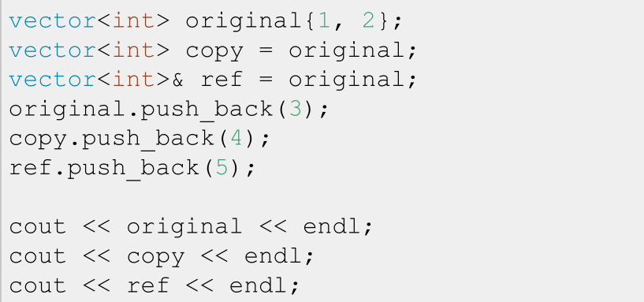
References to variables

Slide 36
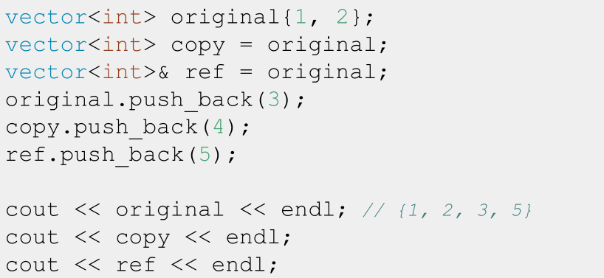
References to variables

Slide 37
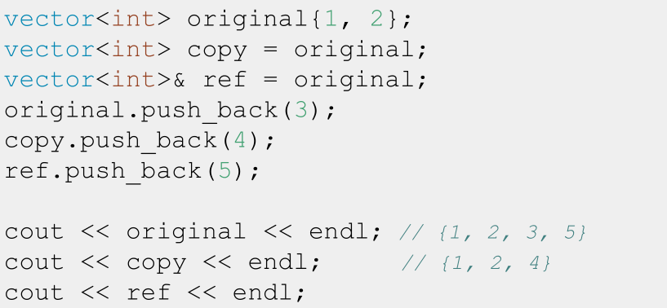
References to variables

Slide 38
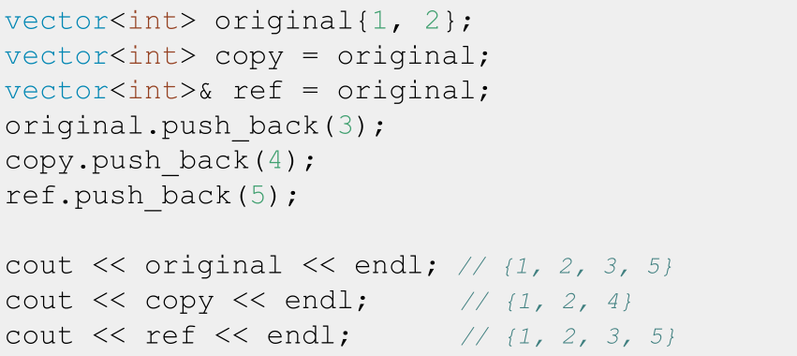
References to variables

Slide 39
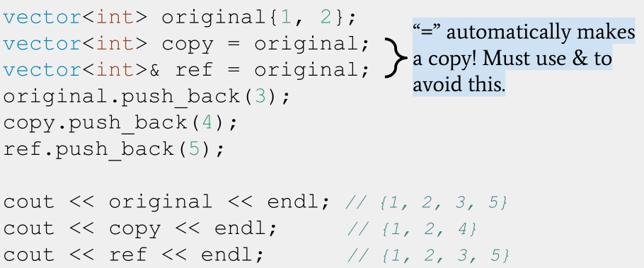
References to variables

Slide 40
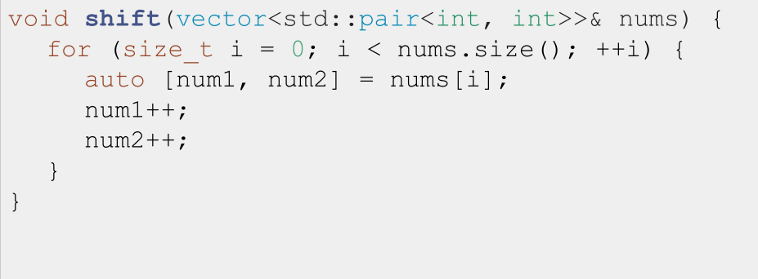
The classic reference-copy bug 1.0:

Slide 41
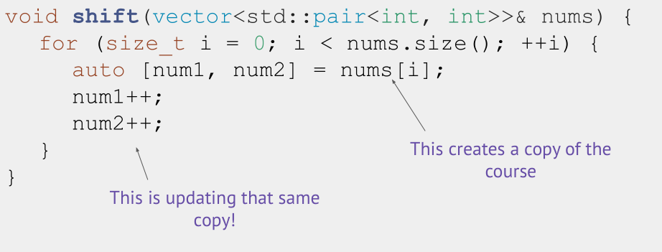
The classic reference-copy bug 1.0:

Slide 42
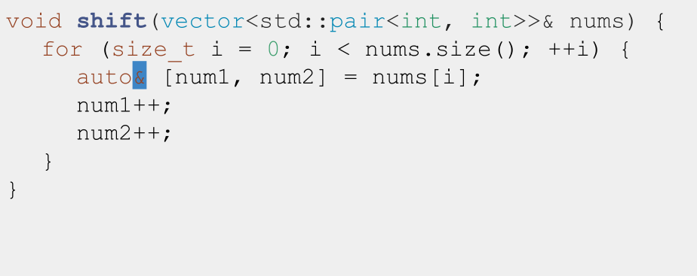
The classic reference-copy bug 1.0: Fixed

Slide 43
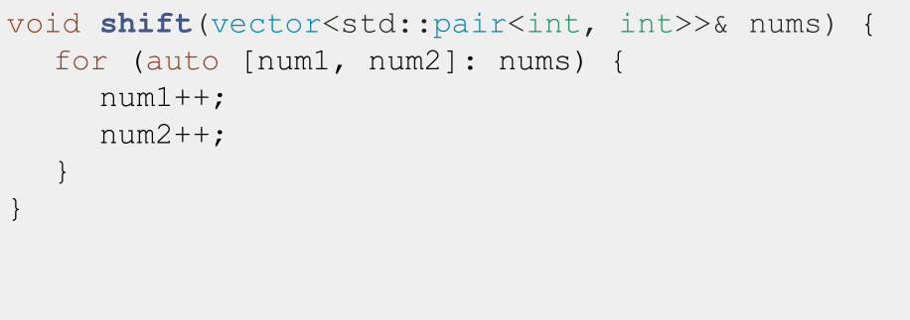
The classic reference-copy bug 2.0:

Slide 44
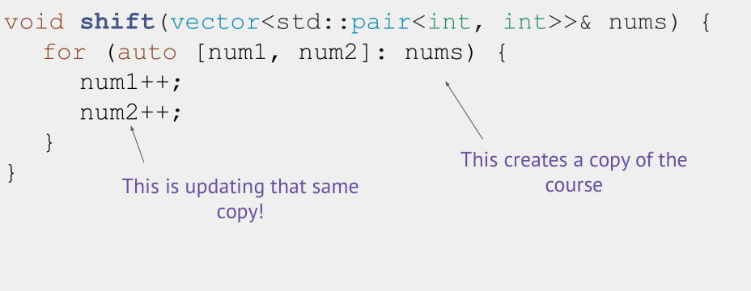
The classic reference-copy bug 2.0:

Slide 45
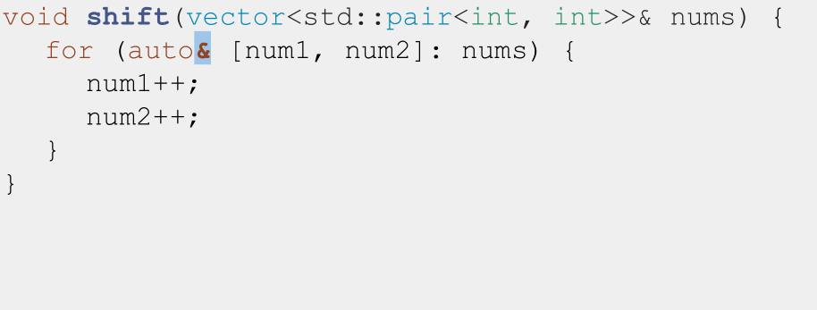
The classic reference-copy bug 2.0, fixed:

Slide 46
Definition: l-values vs r-values
- l-values can appear on the
left or right of an =
- x is an l-value
l-values have names
l-values are not
temporary
- r-values can ONLY appear on the right of an =
- 3 is an r-value
r-values don’t have names
r-values are temporary
int x = 3;
int y = x;
int x = 3;
int y = x;

Slide 47
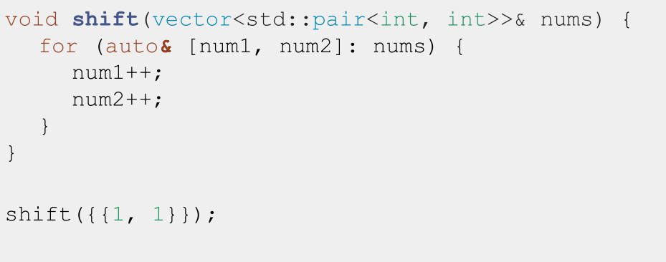
The classic reference-rvalue error

Slide 48
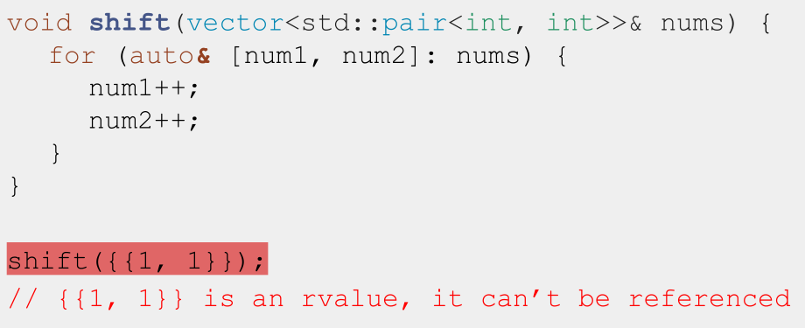
The classic reference-rvalue error

Slide 49
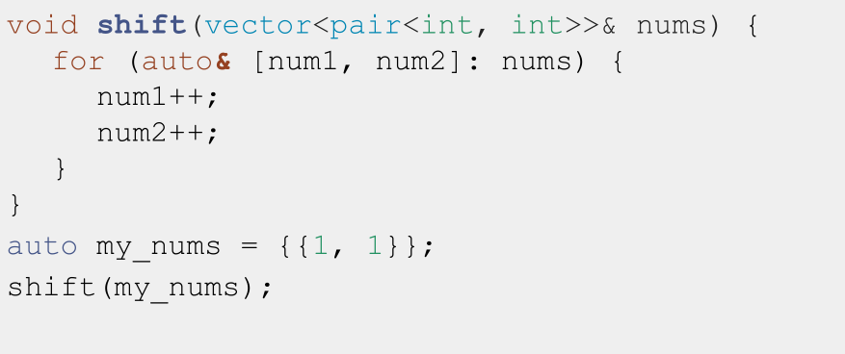
The classic reference-rvalue error, fixed

Slide 50
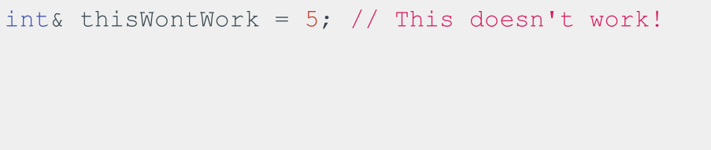
Note: You can only create references to variables

Slide 51
Today
- Initialization
- Using auto
- References
- If time: Const

Slide 52
BONUS: Const and Const References

Slide 53
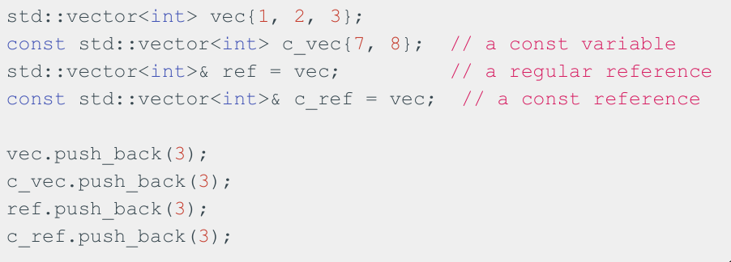
const indicates a variable can’t be modified!
const variables can be references or not!

Slide 54
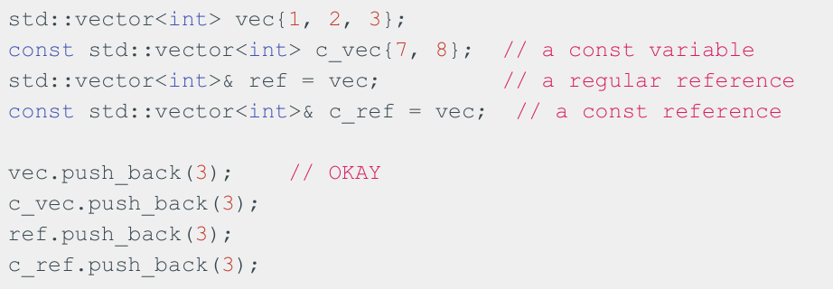
const indicates a variable can’t be modified!
const variables can be references or not!

Slide 55
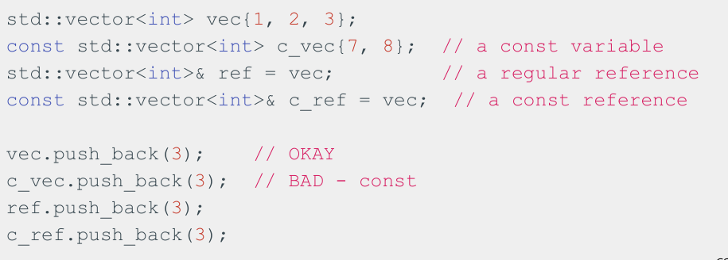
const indicates a variable can’t be modified!
const variables can be references or not!

Slide 56
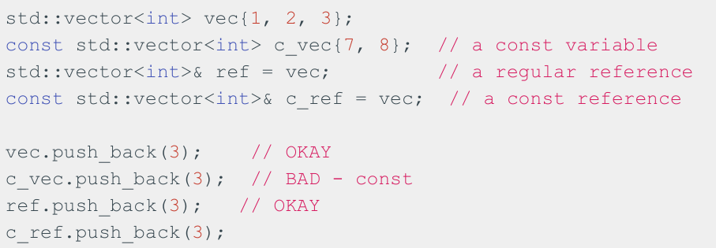
const indicates a variable can’t be modified!
const variables can be references or not!

Slide 57
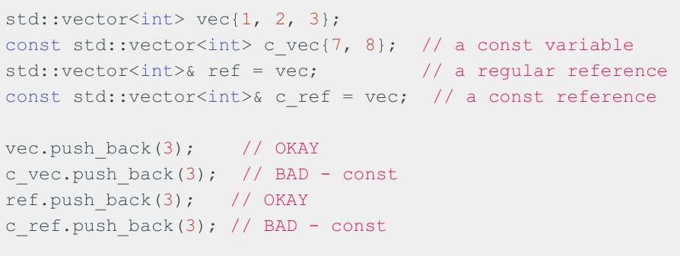
const indicates a variable can’t be modified!
const variables can be references or not!

Slide 58
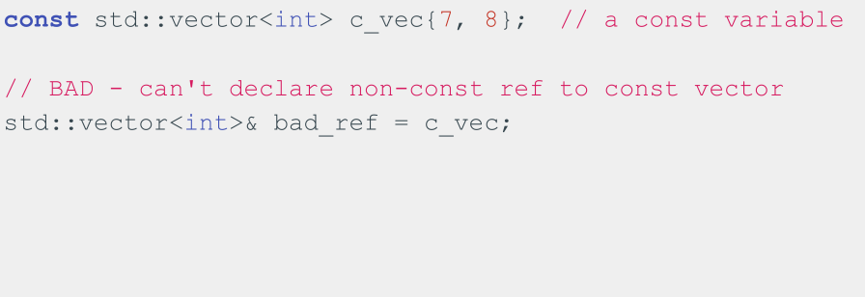
Can’t declare non-const reference to const variable!

Slide 59
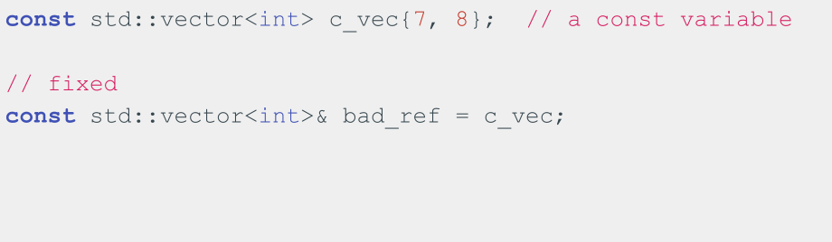
Can’t declare non-const reference to const variable!

Slide 60
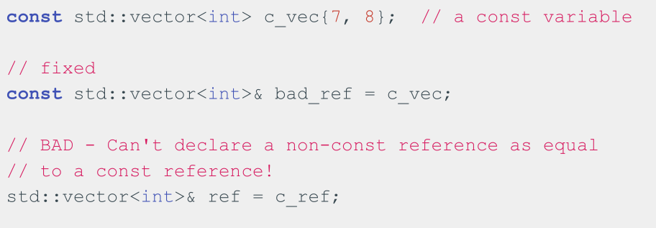
Can’t declare non-const reference to const variable!

Slide 61
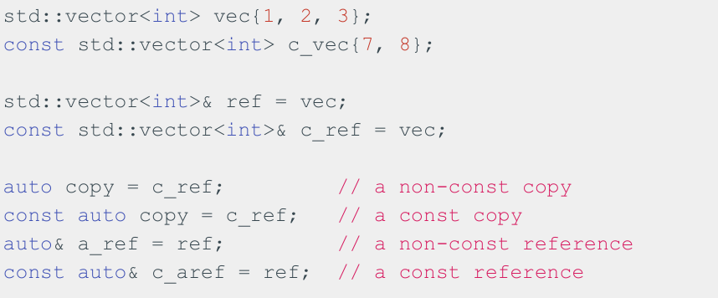
const & subtleties

Slide 62
Remember: C++, by default, makes copies when we do variable assignment! We need to use & if we need references instead.

Slide 63
When do we use references/const references?
- If we’re working with a variable that takes up little space in memory (e.g. int, double), we don’t need to use a reference and can just copy the variable
- If we need to alias the variable to modify it, we can use references
- If we don’t need to modify the variable, but it’s a big variable (e.g. std::vector), we can use const references

Slide 64
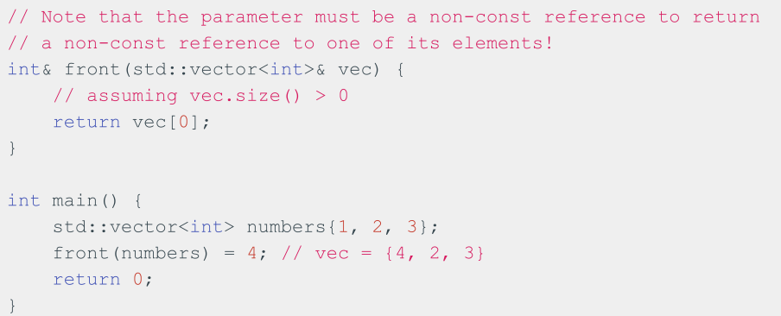
You can return references as well!

Slide 65
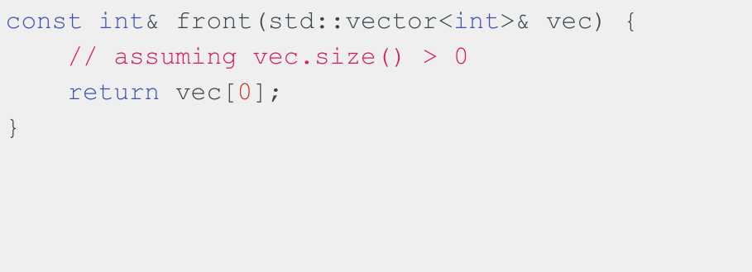
Can also return const references

Slide 66
Recap
- Uniform Initialization
- A “uniform” way to initialize variables of different types!
- References
- Allow us to alias variables
- Const
- Allow us to specify that a variable can’t be modified

Slide 67
Coding for love, Coding for the world
Qijun Zhao
qjzhao@scu.edu.cn

